Slide 1
Welcome to Back-to-School Night!
Mrs. Lea Welch
Geometry

Slide 2
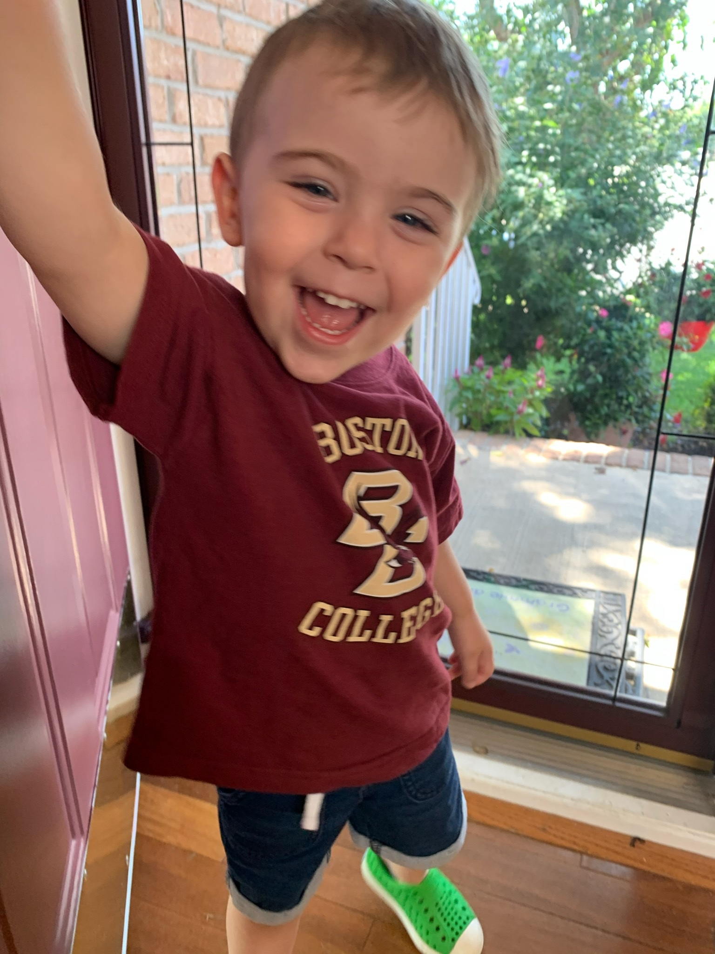
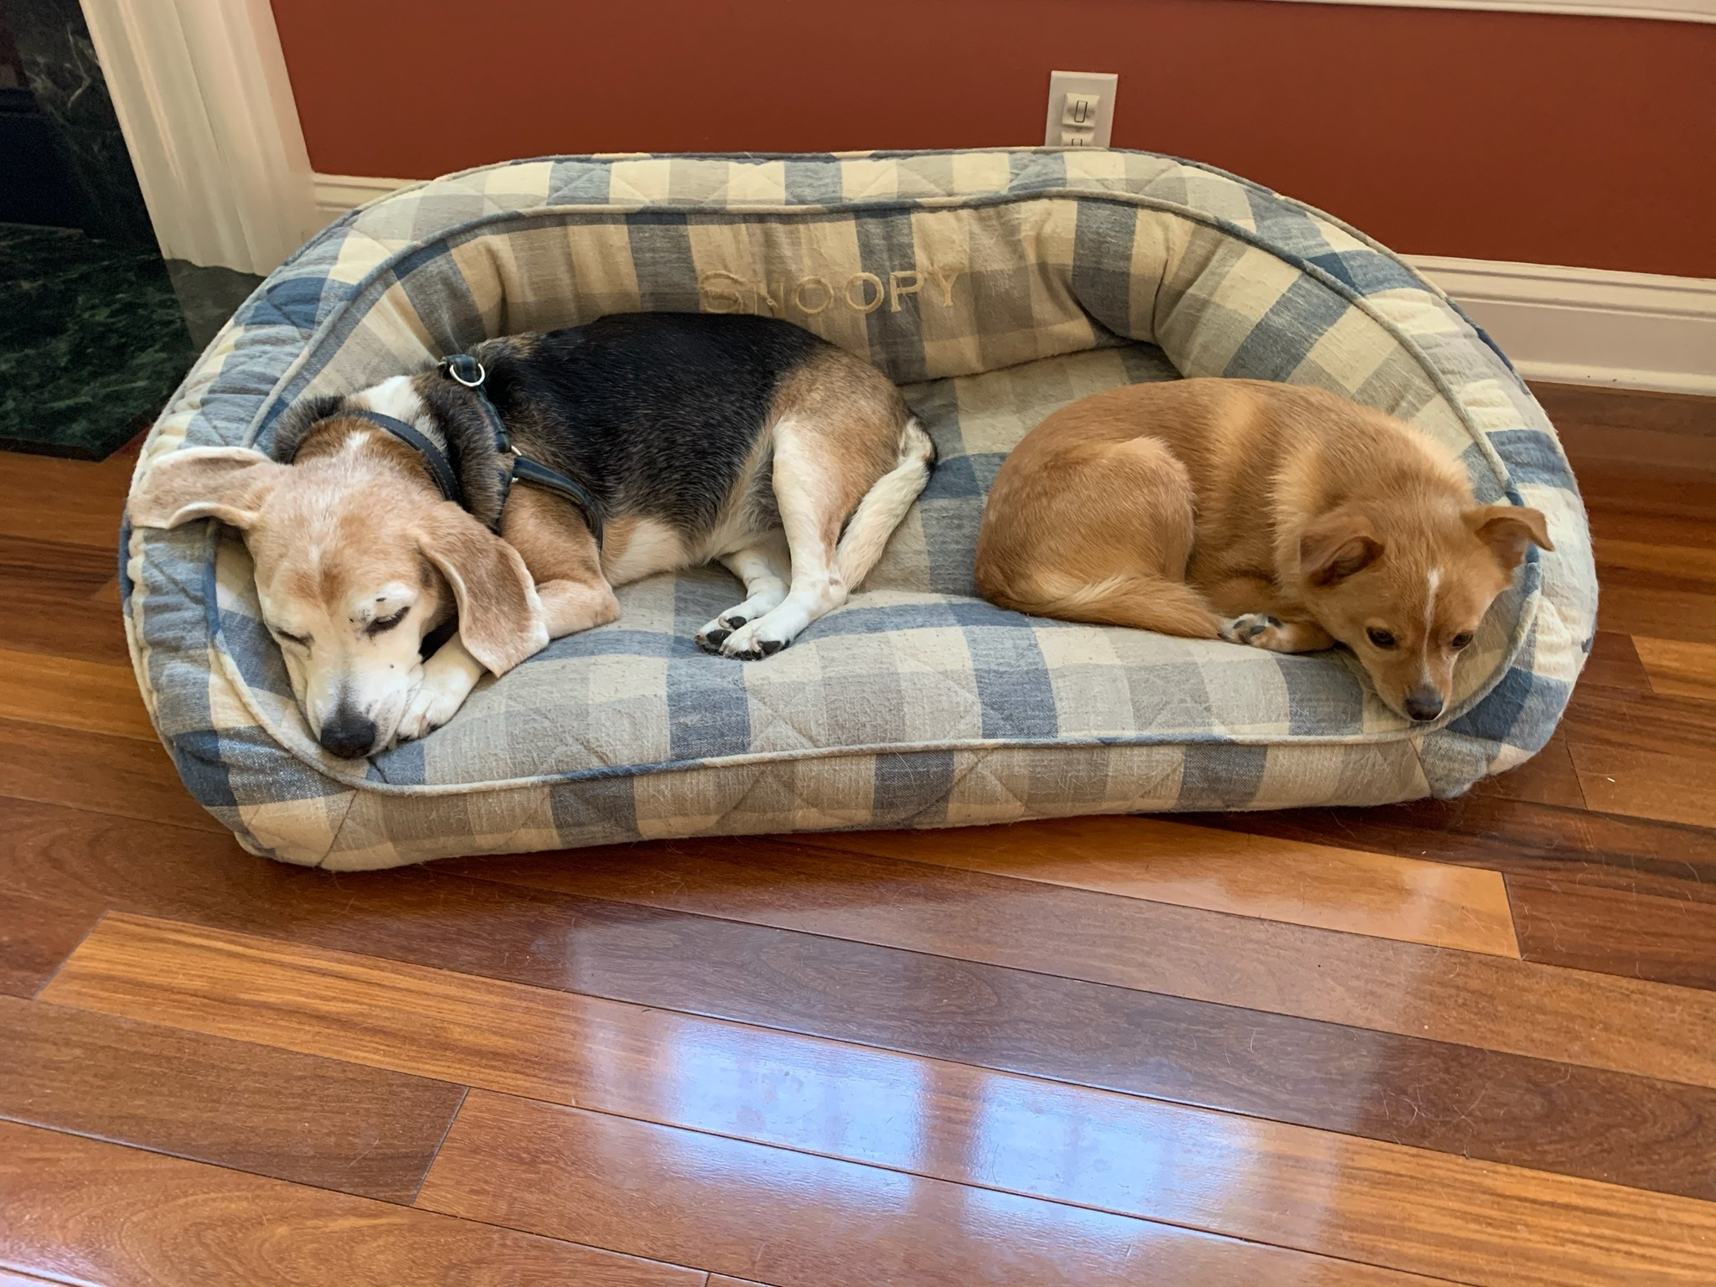
Introduction
Mrs. Lea Welch
This is my 8th year at Perth Amboy High School.
I have taught Algebra 1, Geometry, Algebra 2, College Math, Consumer Math, Financial Literacy, Human and Physical Geography, Latin American Studies, and US History 2.
My husband and I have an awesome 2.5 year old son, Anthony, and 2 crazy dogs, Snoopy and Reggie.

Slide 3
Contact Information - Mrs. Lea Welch
My email is leawelch@paps.net
Please feel free to contact me with any questions or concerns.
Contact Hours: Mon–Fri:
8:00 AM – 9:30 AM
2:15 PM – 3:10 PM
In your email please identify your student and the best number and time for me to reach you.

Slide 4
Subject Curriculum
1. Transformations and Tools of Geometry
2. Algebra and Proofs in Geometry
3. Parallel and Perpendicular Lines
4. Congruent Triangles
5. Proportions and Similarity
6. Right Triangles and Trigonometry
7. Circles
8. Quadrilaterals & Coordinate Geometry
9. Surface Area and Volume
10. Relationships in Triangles
**Note: Currently, we are moving at a much slower pace than usual due to online instruction only.

Slide 5
Classroom/Remote Expectations
Be Visible: Remain on camera the whole the class period.
(Report any problems to the technology help desk, and forward us a copy of the “ticket”)
Speak when called on: It’s a class, not a show. Students need to participate. (Otherwise keep the microphone off so we can all hear ourselves).
Be on time: It’s not fair to have to explain everything again for latecomers. (Report any issues/concerns to the teacher, privately, not in front of the class if possible)
Complete your Work: Do it and send it in. That’s how one earns their grade!

Slide 6
Grading
Tests, essays, quizzes, projects and all other assessments (both formal and informal) are worth 60%.
Classwork is worth 35% (Classwork includes Participation!)
Homework is worth 5%
This grading system is the same throughout the high school.

Slide 7
Grading (continued)
Classwork Assignments
We provide students time in class to complete their assignments. If they do not complete it in class, then they have until 10:00 PM that night to submit for full credit. Late assignments may be accepted the next day, minus a small penalty (10%)
Quizzes and Assessments
Due to remote learning, we will only be assigning short quizzes that students should be able to complete in class. However, there may be times that students need to complete on their own as well at which point they may ask us to setup a Meet and finish the quiz.

Slide 8
Resources
Guidance Department
Scheduling as well as other concerns.
Extra Help:
I may be available for extra help after school on a mutually agreed upon day and time via Meet.

Slide 9
Q&A
Any questions?

